Slide 1

Exploratory Data Analysis for Customer Churn Prediction in Telecommunication
Analyzing Data to Boost Customer Retention

Slide 2

About Me:
e
01
Kumar Raju N
B Com(Gen)
Why you want to learn Data Science
I want to be a detective but instead of that I choose Data Science because, Data science is like being a detective for information. You can gather clues (data) and solve mysteries (problems) by analyzing them closely.

Slide 3
Agenda:
Introduction to the Dataset:
Overview of the telecommunication dataset and its relevance to customer churn prediction.
Data Exploration:
Unveiling key features and understanding their significance in predicting customer churn.
Data Cleaning and Preparation:
Handling missing values and encoding categorical variables for analysis.
Exploratory Data Analysis (EDA):
Uncovering insights through visualizations and statistical analysis.
Model Building and Evaluation:
Implementing machine learning algorithms to predict customer churn.
Assessing model performance using accuracy metrics.
Comparative Analysis of Models:
Comparing the effectiveness of different predictive models in identifying churn.
Key Findings and Insights:
Summarizing the most significant discoveries from the EDA process.
Recommendations for Action:
Providing actionable recommendations for improving customer retention strategies.
Conclusion and Next Steps:
Concluding remarks on the EDA findings and outlining future steps for the project.

Slide 4
Business Problem:
The telecommunications industry faces the challenge of high customer churn rates, which adversely affect revenue and profitability. Identifying and retaining customers who are at risk of churn is crucial for sustaining business growth in this competitive market.
Objectives:
Predictive Analysis: Develop predictive models to forecast customer churn based on historical data and customer attributes.
Insight Generation: Uncover key factors influencing churn through exploratory analysis, providing actionable insights for targeted retention strategies.
Enhanced Customer Retention: Implement data-driven approaches to enhance customer retention efforts and mitigate churn, ultimately improving business sustainability and profitability.

Slide 5
Summery:
Overview:
Total Records: 7043
Total Features: 46
Target Variable - Churn:
Churned Customers: 1869 (26.54%)
Retained Customers: 5174 (73.46%)
Summary Statistics for Numerical Features:
SeniorCitizen: Mean=0.162, Std=0.369, Min=0, Max=1
Tenure: Mean=32.37, Std=24.56, Min=0, Max=72
MonthlyCharges: Mean=64.76, Std=30.09, Min=18.25, Max=118.75
TotalCharges: Mean=2281.92, Std=2265.27, Min=18.80, Max=8684.80
There are no missing values in the dataset.

Slide 6




Libraries Used
Pandas: Used for data manipulation and analysis, including loading the dataset, data preprocessing, and summarization.
NumPy: Utilized for numerical computing, providing support for handling arrays and mathematical operations on the data.
Matplotlib: Employed for data visualization, enabling the creation of various plots and charts to explore the dataset visually.
Scikit-learn: Used for machine learning tasks such as data preprocessing, model building, and evaluation, including algorithms like KNN, Logistic Regression, SVM, Decision Trees, and Random Forest.

Slide 7
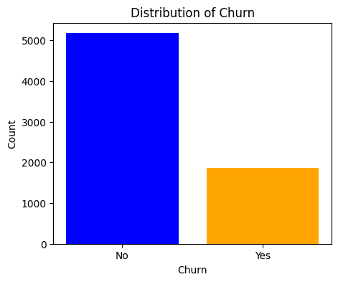
Distribution of Churn
The distribution of churn is imbalanced, with the majority of customers not churning (blue bar).
This imbalance should be taken into account when modeling, as it can affect the performance of the model.

Slide 8
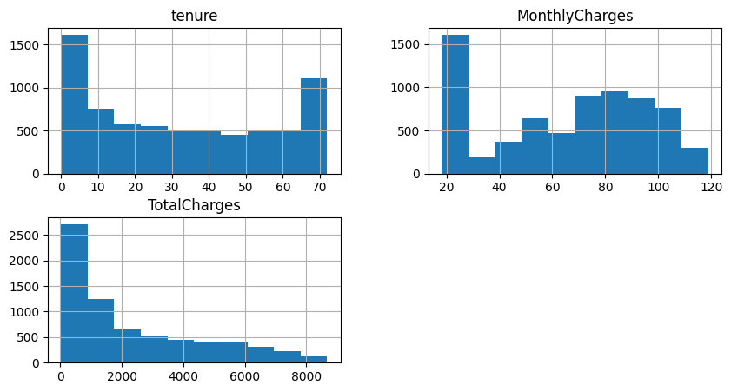
Univariate Analysis - Numerical Features
Tenure:
The distribution is right-skewed, indicating that most customers have been with the company for a shorter duration.
There is a small peak at around 70 months, which could indicate a group of customers who have been with the company for a long time.
Monthly Charges:
The distribution is roughly bell-shaped, with most customers paying between $20 and $100 per month.
There are a few outliers with very high monthly charges.
Total Charges:
The distribution is right-skewed, similar to tenure.
There are a few outliers with very high total charges

Slide 9
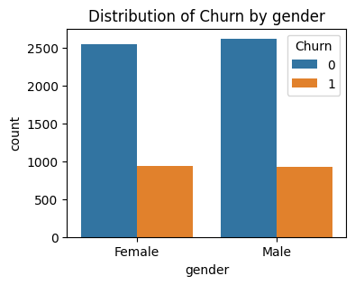
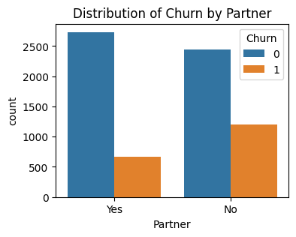
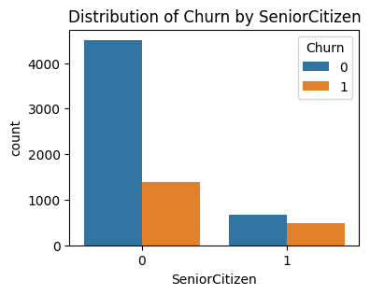
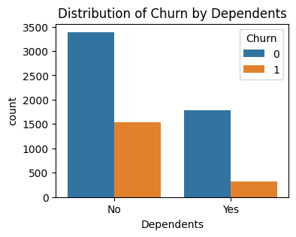
Univariate Analysis - Categorical Features
Gender:
There is a slightly higher proportion of female customers who churn compared to male customers.
Senior Citizen:
Senior citizens have a higher churn rate than non-senior citizens.
Partner:
Customers with partners have a slightly lower churn rate than those without partners.
Dependents:
Customers with dependents have a slightly lower churn rate than those without dependents.

Slide 10
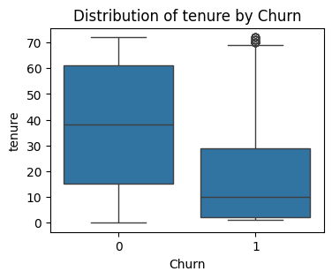
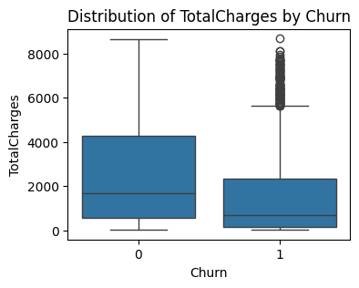
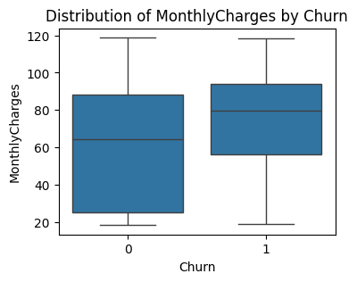
Bivariate Analysis - Numerical Features
Tenure:
Churned customers tend to have lower tenure than non-churned customers.
Monthly Charges:
There is no significant difference in monthly charges between churned and non-churned customers.
Total Charges:
Churned customers tend to have lower total charges than non-churned customers.

Slide 11
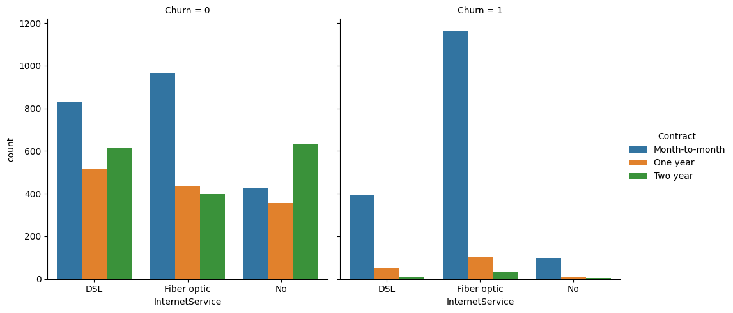
Pairwise Categorical Plots
Customers with fiber optic internet service and month-to-month contracts have the highest churn rate.
Customers with DSL internet service and two-year contracts have the lowest churn rate.
There is a general trend of higher churn rates for customers with month-to-month contracts and lower churn rates for customers with two-year contracts.
Fiber optic internet service seems to have a higher churn rate compared to DSL and no internet service.

Slide 12

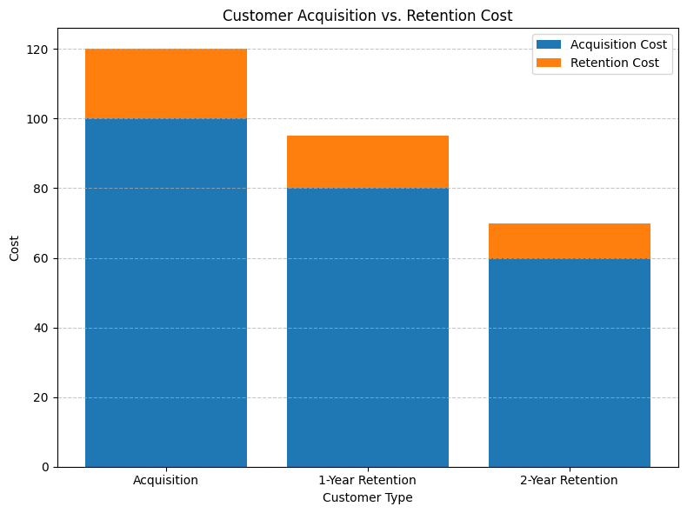
Customer Acquisition vs. Retention Cost
Acquisition cost is significantly higher than retention cost for all customer types.
The highest cost is associated with acquiring new customers.
The cost of retaining customers decreases as the customer tenure increases.
This highlights the importance of customer retention strategies to reduce overall costs.

Slide 13
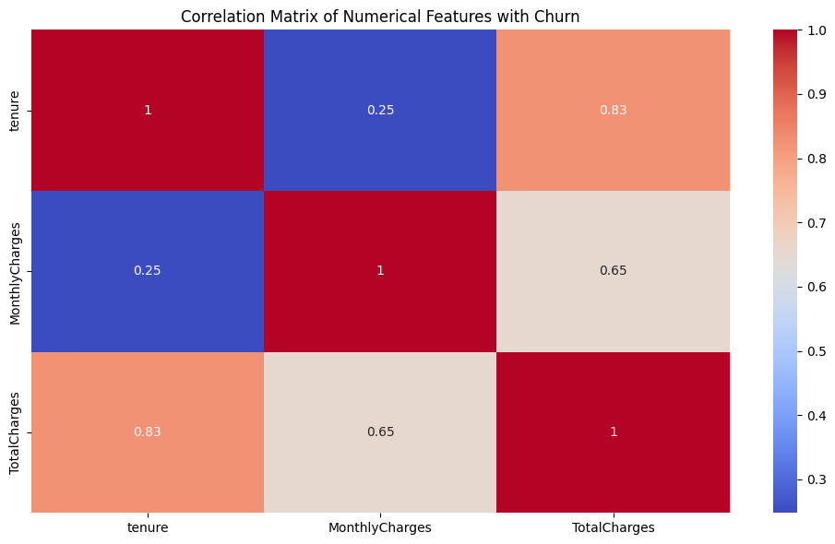
Correlation Matrix of Numerical Features:
Tenure has a moderate negative correlation with churn, suggesting that customers with longer tenure are less likely to churn.
Monthly charges and total charges have weak positive correlations with churn.

Slide 14
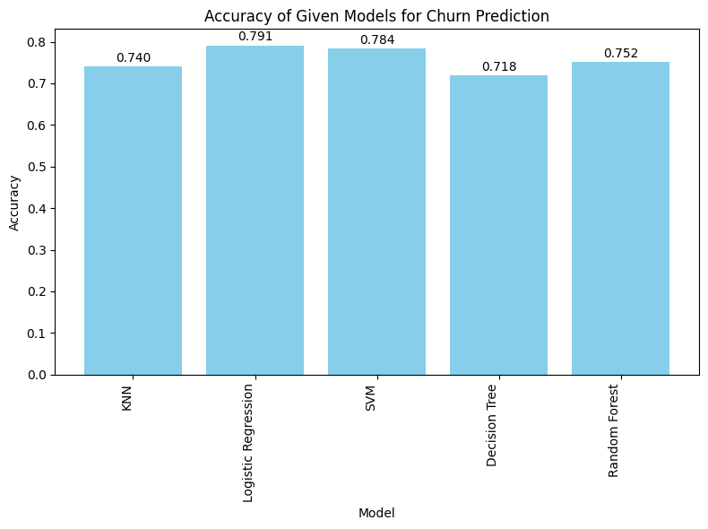
Accuracy Comparison of Different Machine Learning Models
Logistic Regression achieved the highest accuracy of 79.1%.
Random Forest and KNN achieved comparable accuracies of 76.3% and 74.7%, respectively.
Support Vector Machines and Decision Trees had slightly lower accuracies of 78.4% and 71.5%, respectively.

Slide 15
Conclusion :
Based on the results, Logistic Regression is the best algorithm for churn prediction in this case. It achieved the highest accuracy and outperformed other models. This suggests that Logistic Regression is able to learn the relationships between the features and the target variable (churn) effectively.

Slide 16

THANK YOU

